Slide 1

Project for
Loan Prediction
Project Creator
Navnath Satre
Vaibhav Bansode
Divya Bagadi
Bharath A V
Sandeep Khandelwal
Mentor Name:-Mr. Parth
EXCELR
Project Group
P53-Group-4

Slide 2
Business Problem:
To predict the impact of the incident raised by the customer.
Objective:
The objective of the analysis is to predict loan eligibility process (real time) based on customer detail provided.

Slide 3
Project Flow

Slide 4
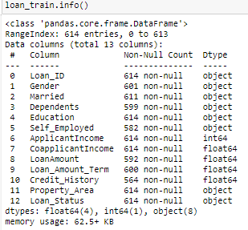
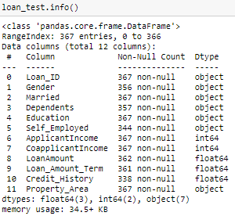
Exploratory Data Analysis (EDA)
Looking both the Datasets
Training Dataset
Test Dataset

Slide 5


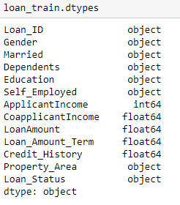
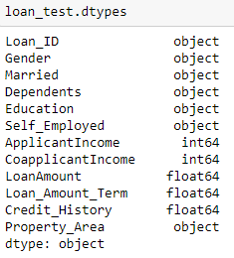
Shape & DataType in Train & Test Data

Slide 6
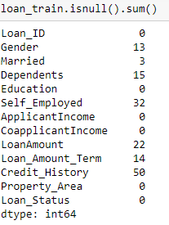
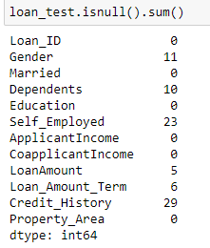
Null Values in both Train and Test Data

Slide 7
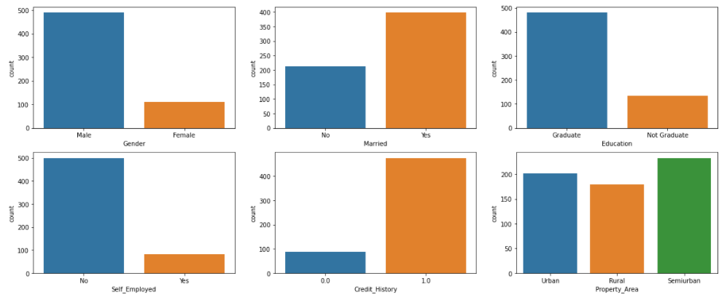
Univariate Analysis on Categorical Data
Mostly, those who Male, Married, Graduated, Not Self-Employed they applied for Loan. Those who a high Credit_History (1.0) they mostly applied for Loan. From any Property_Area people applied for Loan.

Slide 8
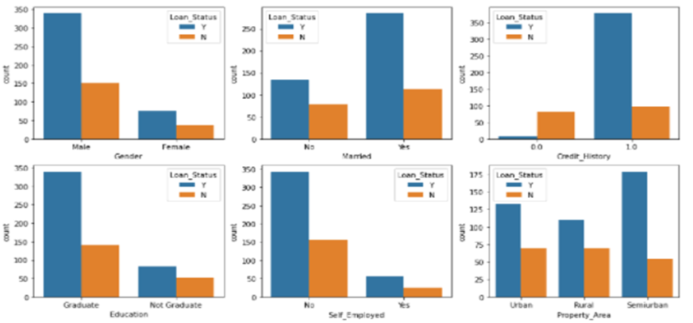
Bivariate Analysis
Bar Chart on Categorical Data

Slide 9
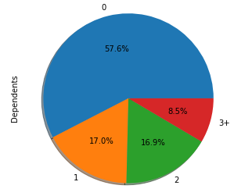
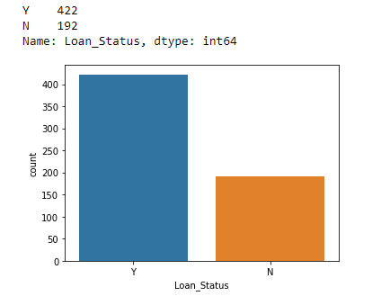
Mostly those who have NO dependents they applied for Loan
From above, data is imbalanced we need to balance it.

Slide 10
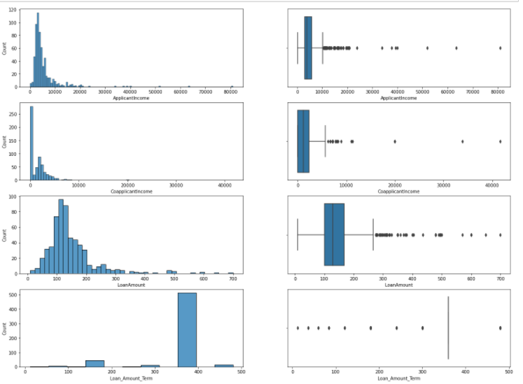
Continuous Variables:
Our data is Not Normal (Right Skewed) and Huge Outliers in ApplicantIncome.,CoapplicantIncome,LoanAmount &Loan_amount_term is only 360.

Slide 11


Data Preprocessing
Treating Null Values
Mode is used to treat null values in Categorical Data
BackFill is used to fill null values in Numerical Data

Slide 12
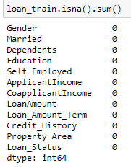
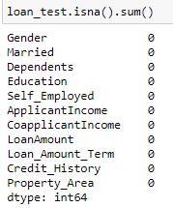
All Null Values from Train and Test has been treated.

Slide 13
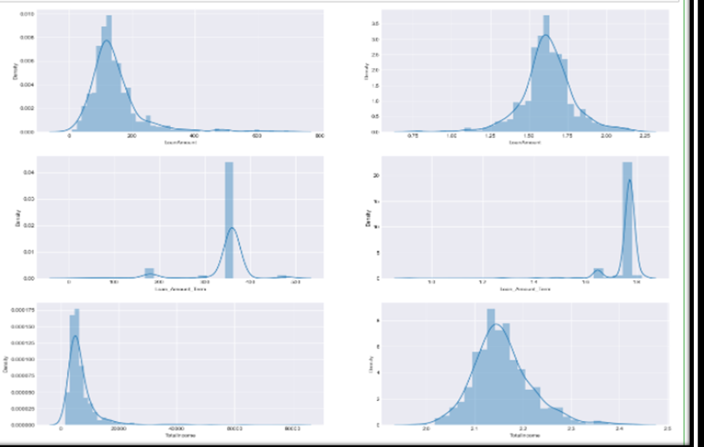
Outlier detection & Treatment

Slide 14
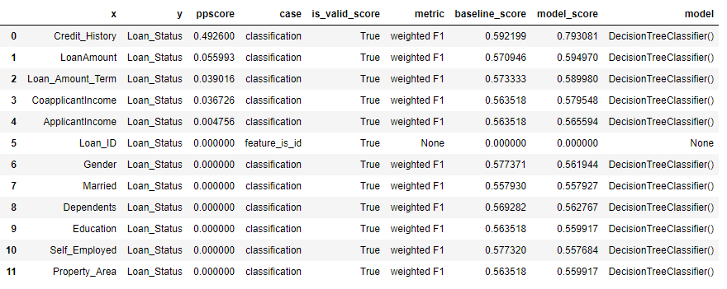
Feature Engineering
By Using PPS

Slide 15
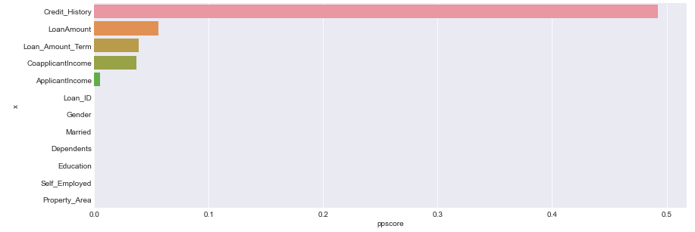

Slide 16

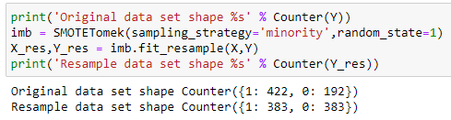
Unbalanced Classes
We use SMOTETomek analysis and do Oversampling to give model equal chances to classify data.

Slide 17
Model Summary

Slide 18
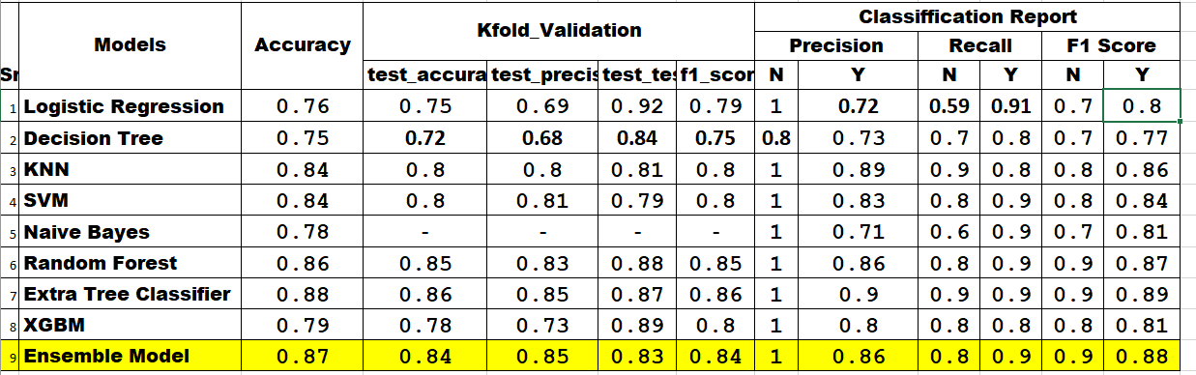

Slide 19
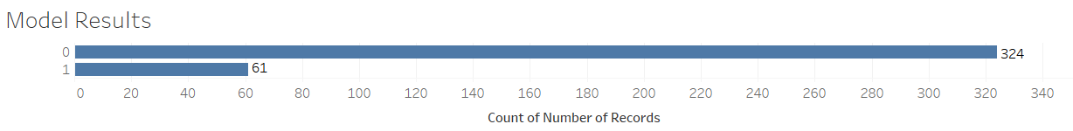
Model Results
Example
Model generated the output for the transaction data set in which 324 transactions are genuine(0) claims and 61 transaction are fraudulent(1)

Slide 20
Model Deployment using R shiny / Flask or any other method

Slide 21
Challenges faced?
How did you overcome?

Slide 22
Thank you

